Slide 1
DMC COALITION
Introduction to Insurance
Presented By: Corey Broadhurst
Insurance Advisor
Brown & Brown of Orlando

Slide 2
Presentation Agenda
1
About Brown & Brown Insurance
2
Risk Management Program Overview
3
Coverage Review Process
4
Questions

Slide 3
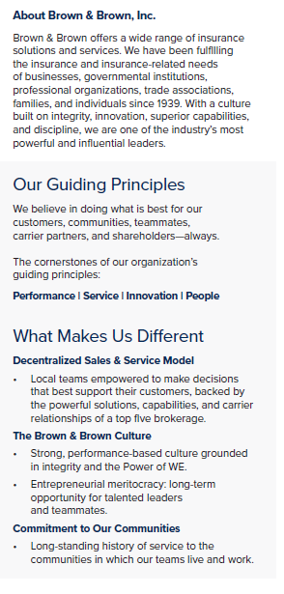
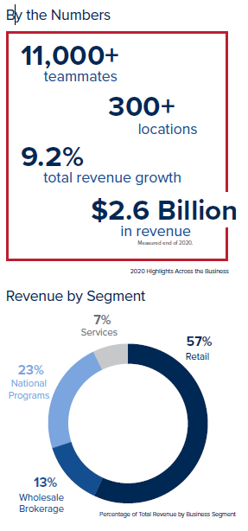
Brown & Brown Insurance

Slide 4
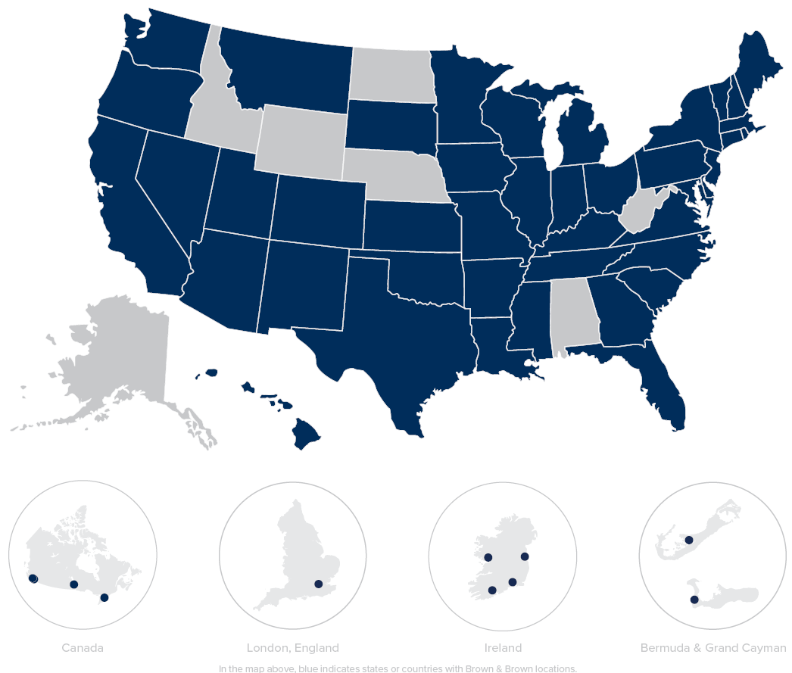
Brown & Brown Insurance
Global Footprint

Slide 5
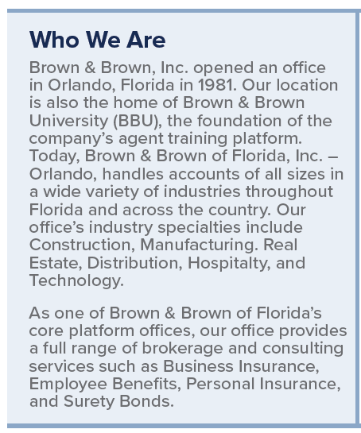
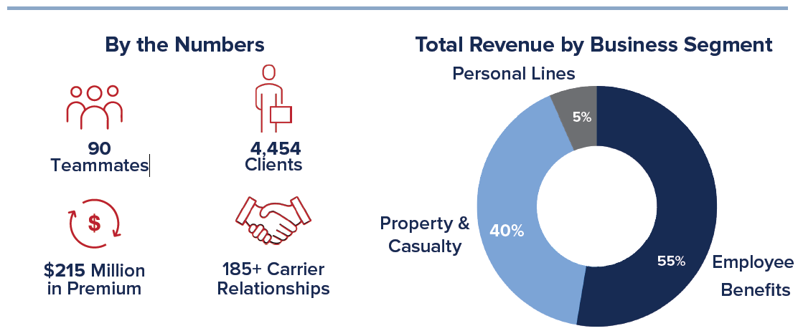
Brown & Brown Insurance
Orlando Office

Slide 6
Risk Management Program
Workers’ Compensation
General Liability
Business Automobile
Umbrella/Excess
Errors & Omissions (Professional Liability)
Commercial Property
Crime
Employment Practices Liability Insurance (EPLI)
Cyber Liability

Slide 7
Workers’ Compensation
Provides benefits to employees who suffer work-related injuries or illness
Rules vary by state, however, most states follow rules designated by the NCCI
Not providing Workers’ Compensation can result in imprisonment or a fine
Fines in California can reach up to $100,000
Schedule A- BENEFITS
Death Benefit
100% Medical Expense Benefit
Disability or Indemnity Benefit
Permanent Impairment Rating
Schedule B- Employers Liability
$1,000,000- Each Disease
$1,000,000- Disease Aggregate
$1,000,000- Disease Occurrence

Slide 8
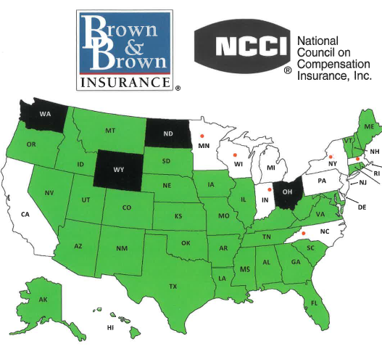
Workers’ Compensation

Slide 9
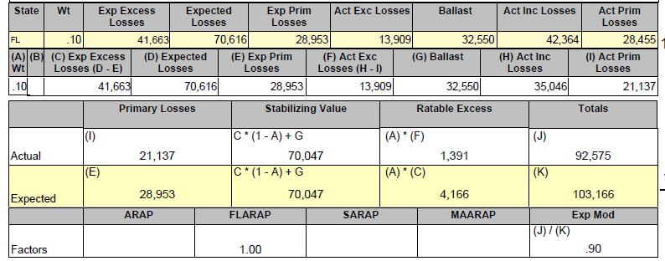
Workers’ Compensation
Premium
Based on class code (scope of job) and payroll
Rate x (Payroll/$100)
Experience Modification Factor
Based on 3 years of claims history
Results in a Discount or Surcharge

Slide 10
Workers’ Compensation
How DMCs Save Money
Return to Work Program
70% reduction in MOD penalty
Drug Free Workplace (5% Discount FL)
Formal Safety Program (2% Discount FL)
Dividends
Monthly Self-Audit

Slide 11
General Liability
Protects against liability claims for bodily injury (BI) and property damage (PD) arising out of premises, operations, products, and completed operations; and advertising and personal injury (PI) liability.

Slide 12
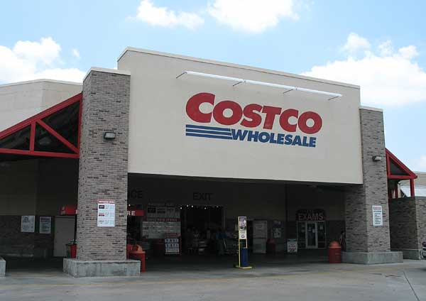
General Liability
How DMCs Save Money
Claims Management
Strong Narrative/Company Info
Think Costco!
Accurately report Exposures (Revenues)
Increased Exposure=Decreased Rate
Avoid Large Audits
Mid-term Exposure endorsement

Slide 13
Business Automobile
Common DMC Issues
Insurable Interest
Title or Lease Agreement
Hired/Non-Owned Coverage
Can be endorsed to General Liability Policy
Vicarious Liability Issues
How DMCs Save Money
Telematics (GPS)
Strong Driver Guidelines
Personal Insurance Requirements
MVRs

Slide 14
Umbrella/Excess
Provides additional limits of insurance excess of primary limits
Umbrella/Excess ($5m)
General Liability($5m) Business Automobile($5m) Workers’ Compensation(500k/500k/500k)

Slide 15
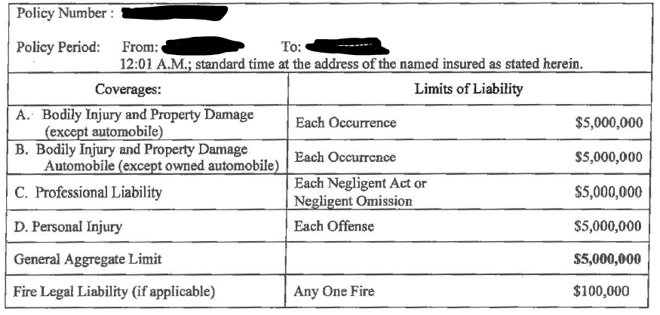
Errors & Omissions (Professional Liability)
Insurance form that protects the insured against liability for committing an error or omission in performance of professional duties. Generally, such policies are designed to cover financial losses rather than liability for bodily injury (BI) and property damage (PD).
Tips for DMCs
Definition of Professional Service
Look for a carrier partner who can write both Professional and General Liability

Slide 16
Additional Lines of Coverage
Crime
Employment Practices Liability Insurance (EPLI)
1st and 3rd party
Cyber Liability

Slide 17
Coverage Review Process
Provide Insurance Info
Coverage Review
Discussion
Policies
Proposals
Insurance Requirements
Contractual Information
Loss History
Highlight Potential Policy Language Issues
Compare Coverage VS. Requirements
Check Market Placement
Share Findings
Determine opportunity to move forward
Notes:
Needs new graphics. Icons are too cheesy looking.

Slide 18
Questions or Comments?
For additional information:
Corey Broadhurst
Commercial Insurance Advisor (321) 214-2392| cbroadhurst@bborlando.com
Brown & Brown of Orlando
Alex Metka
Commercial Insurance Advisor- Small Commercial (321) 214-2327| ametka@bborlando.com
The Cheetah: Since our beginning, we have known that doing the best for our customers requires constant persistence and vision. The cheetah, which represents vision, swiftness, strength, and agility, embodies our company culture and has served as a symbol for Brown & Brown since the 1980s.

